Slide 1
[DRAFT] A portal to (Meta)data
Dena Tahvildari - Bruna dos Santos Vieira
FAIR Data Team
Imaging Group Kick-off Health-RI, 31 August 2023

Slide 2
The Vision
To have a smart research infrastructure where users easily find resources and reuse them

Slide 3
Requirements
Describe resources according to international standards (rich enough and interoperable):
DCAT (EU Health Data Space > DCAT Health, DCAT AP for Portals)
And provide as much as possible semantic enriched metadata (unambiguous, machine-interpretable) for resources of interest
Notes:
To find stuff = We need to Describe stuff (be searchable before findable)
Findability = semantically enriched Metadata (unambiguous)

Slide 4
The Sunflower 1.0
Proteo
KWF
NWO
Metab
Transcrip
Omics
ZonMw
Funders
What Apart from DCAT AP Potals?
Core: Minimal DCAT AP Portals Extended: Health-RI
Leaves (Petals?): - Domain: Imaging data - sub-domains (neuroimaging)
https://github.com/Health-RI/health-ri-metadata/
DCAT AP Portals
(mandatory fields)
Clinical
Biobank
0.9
2.0
CDEs
Cohorts
Rare Diseases
Imaging
PROMS
neuroimaging
DCDEs
Notes:
To find stuff = We need to Describe stuff (be searchable before findable)
Findability = semantically enriched Metadata (unambiguous)

Slide 5
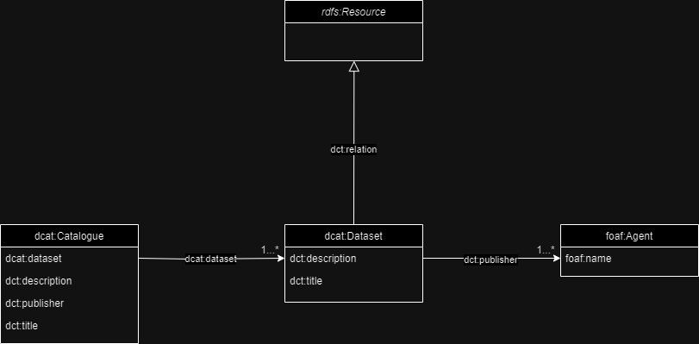
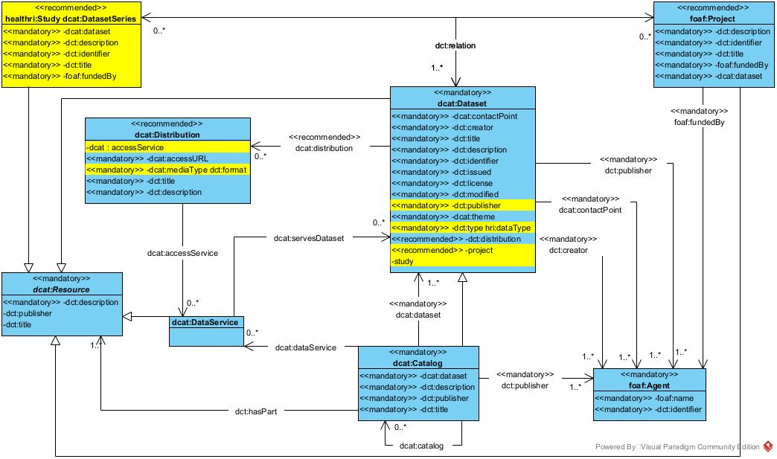
All resources must describe/ provide the core metadata with the core metadata schema
Health-RI core metadata schemas
Funders
Omics
What Apart from DCAT AP Potals?
https://joinup.ec.europa.eu/collection/semic-support-centre/solution/dcat-application-profile-data-portals-europe
DCAT AP Portals
(mandatory fields)
Clinical
Biobank
0.9
2.0
Rare Diseases
Cohorts
Imaging
https://github.com/Health-RI/health-ri-metadata

Slide 6
HRI Core Metadata Schema
Health-RI will supply a generic schema (Core) for resources to increase findability of resources (e.g. datasets)
Nodes extend the core model for covering the specialised domain metadata requirements (Leaves)
Built Based on DCAT, DCAT-AP portals
Represent it in Graph Model (rdf and its other dialects)

Slide 7

Team: HRI Core Metadata Schemas 🌻
Technical Metadata Team (TMT ) will support the technical part of building a metadata schema (Bruna, Dena, Luiz, Kees)
Only domain experts (working groups and portal teams) can define the metadata properties (content).
TMT add main properties from DCAT, DCAT AP portals, and supplied schemas from the nodes
Who will tell, apart from DCAT, which are the other obligatory fields?
Once domain schemas are out for review, TMT can check and embed the obligatory fields in the core schema
Portal groups will review taking into account usability of the schema in health-ri infrastructure (Portal) etc

Slide 8
Defining Core – Generic metadata
Currently we have:
Identified EU standards (DCAT, DCAT AP Portals, DCAT AP Health)
Collected some NL Nodes and Health-RI metadata schemas (RUMC, AUMC, Princess Maxima, Covid Portal)
Mapped all of the above here
For HRI portal release 0.9:
Minimal Core: DCAT-AP Portals mandatory fields
For later (HRI portal release 2.0):
Plan to release HRI Core metadata schema answering: What apart from DCAT AP Portals mandatory fields should be in the HRI core?

Slide 9
Metadata Schema Structure?
is a definition that provides organization to the metadata in the domain, represented in a formal language.
The metadata schema is known as an Ontology and it is represented in the RDF schema (RDFS) or OWL (Web Ontology Language) languages or other dialects (e.g SHACL).
Three main components are:
Classes: is an abstraction mechanism for creating a collection of objects with similar characteristics. The Objects call instances of a class. (e.g. Class(Dataset) and individual(dataset-100) is an instance of it). Class can have hierarchical relationships (subclass) which allows for inheritance and subsumption.
Datatype Property: these are relationships between instances of classes. (e.g. dataset’s title is a datatype property that related all the instance of the class dataset to a string datatype).
Object Property: These are relationships between instances of two classes. For example ”hasDistribution” is an object property that related all the instances of class dataset to instances of class distribution.

Slide 10
Metadata schema is a Graph
Dataset
Distribution
metadata model
hasDistribution
rdf:type
rdf:type
CLASS
Dataset-100
hasDistribution
Distribution_X
Instance of
the metadata
Instance
Relations

Slide 11
Namespace [to add]
dct <>
Owl <>
Rdf <>
Rdfs <>
Hri <>
Foaf <>

Slide 12
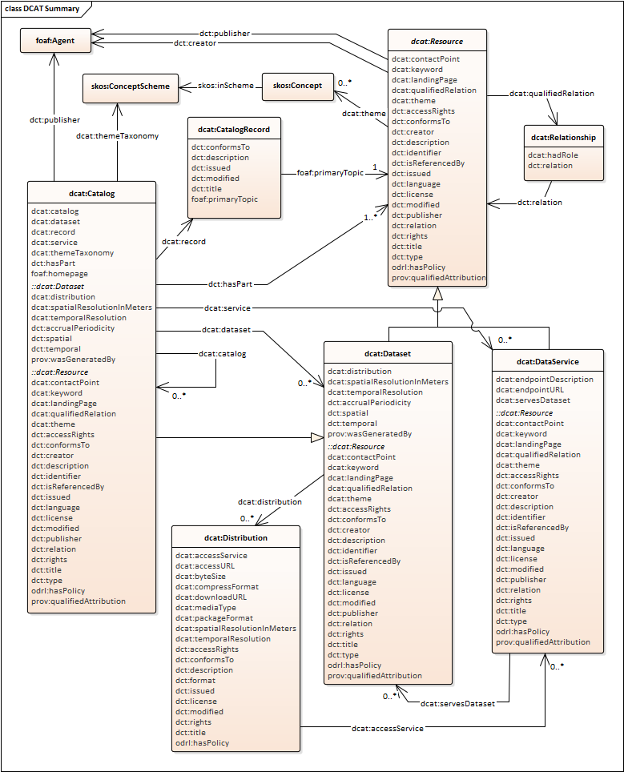
DCAT
DCAT is an RDF vocabulary designed to facilitate interoperability between data catalogs published on the Web.
prefix dcat: <http://www.w3.org/ns/dcat#> .
Main classes:
dcat:Catalogue
dcat:Dataset
dcat:Distribution

Slide 13
DCAT
…and adds extra dataset-specific properties
DCAT Dataset class inherits :: properties of the resource super-class
Notes:
mostra dcat specifica + herdadas

Slide 14
Objectives of DCAT-AP
Supporting the discovery of/access to data in a cross border and cross domain environment, by harvesting data from distributed portals.
In the form of an application profile of W3C DCAT, by:
Expressing constraints and usages on DCAT properties and classes, and
Including additional properties and usages of controlled vocabularies
In such a way that the metadata descriptions are maximally harmonized across Europe, and provide a reliable source for the European Data Portal
Extensions exists to serve different communities better, BregDCAT-AP, GEODCAT-AP, StatDCAT-AP.

Slide 15
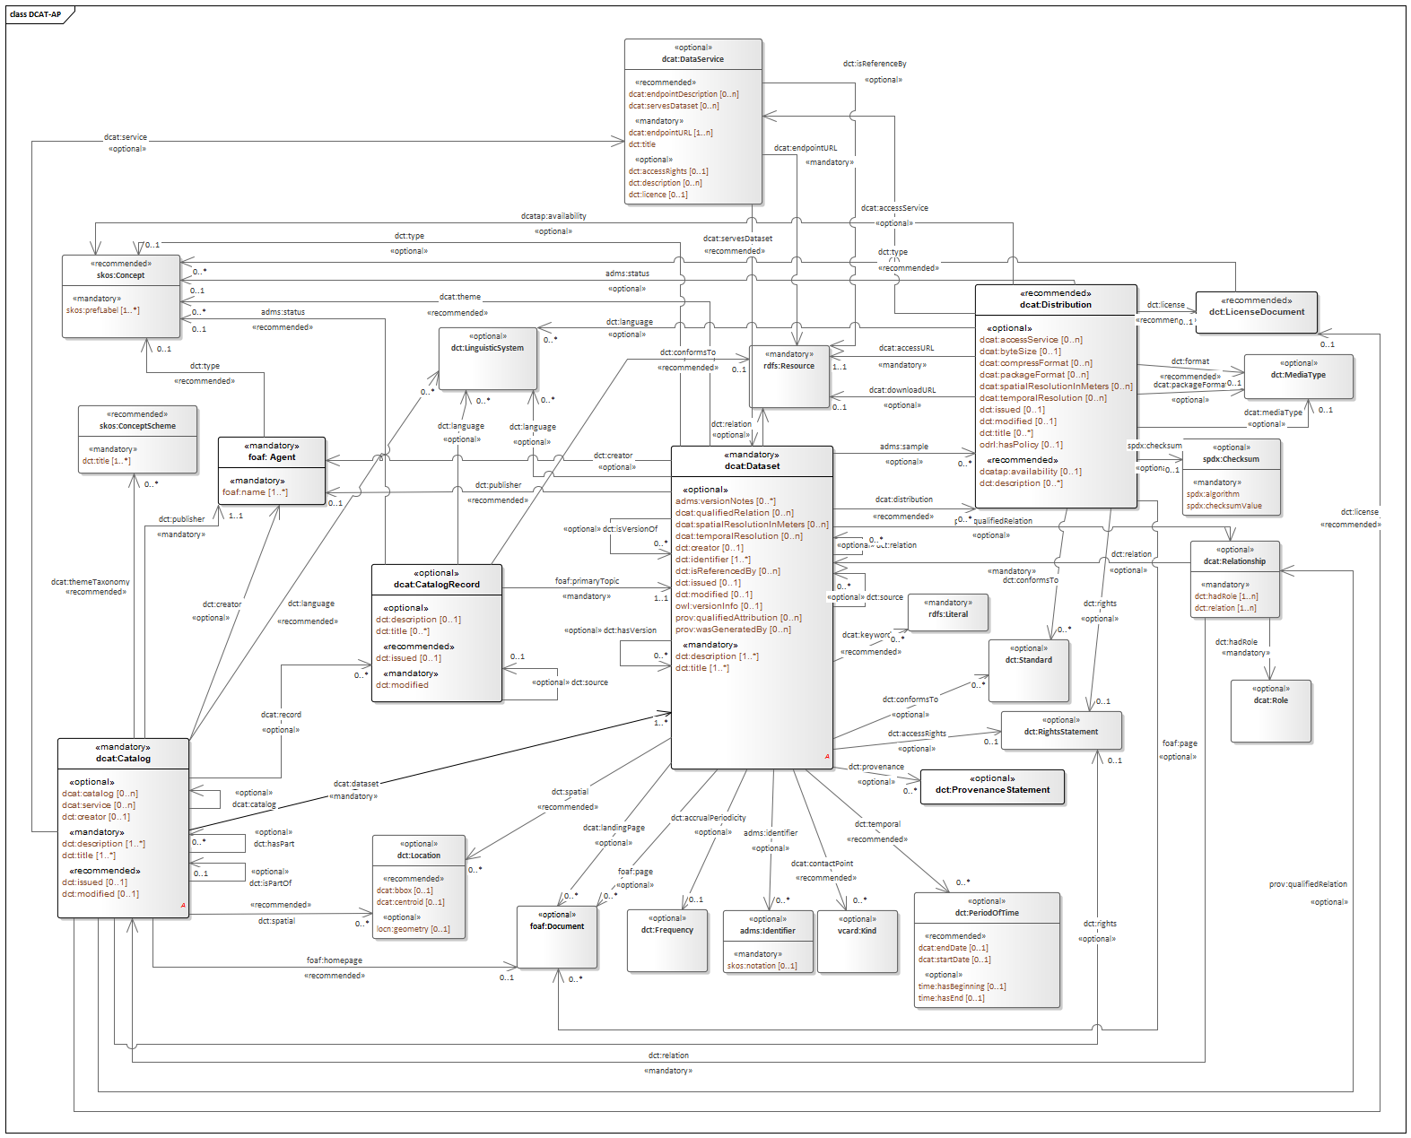
DCAT-AP Portal
Notes:
It is not only extension but constraint defintiions

Slide 16
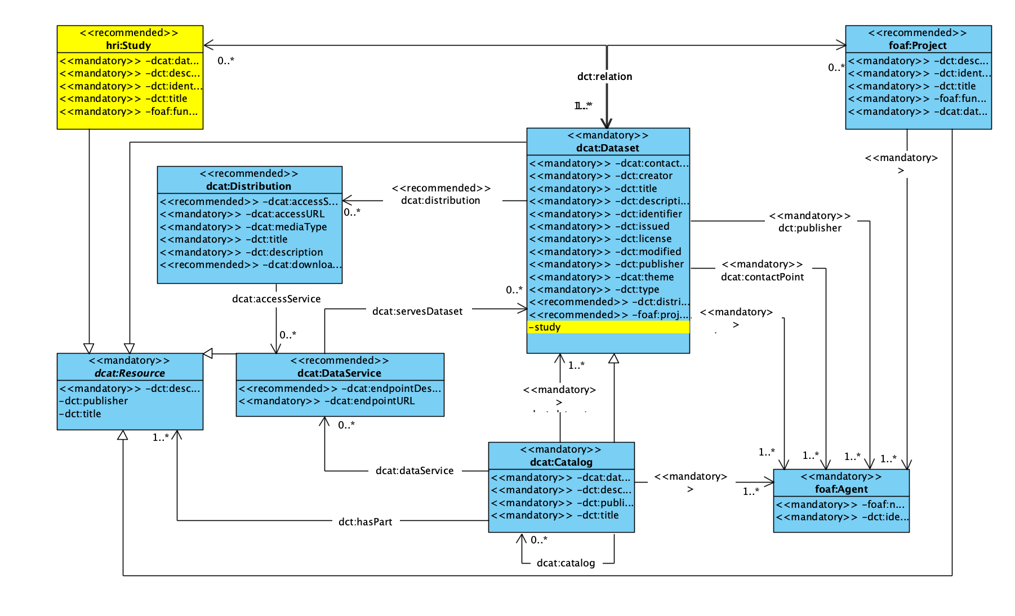
HRI Core schema 0.9 access on git

Slide 17
Practical steps

Slide 18
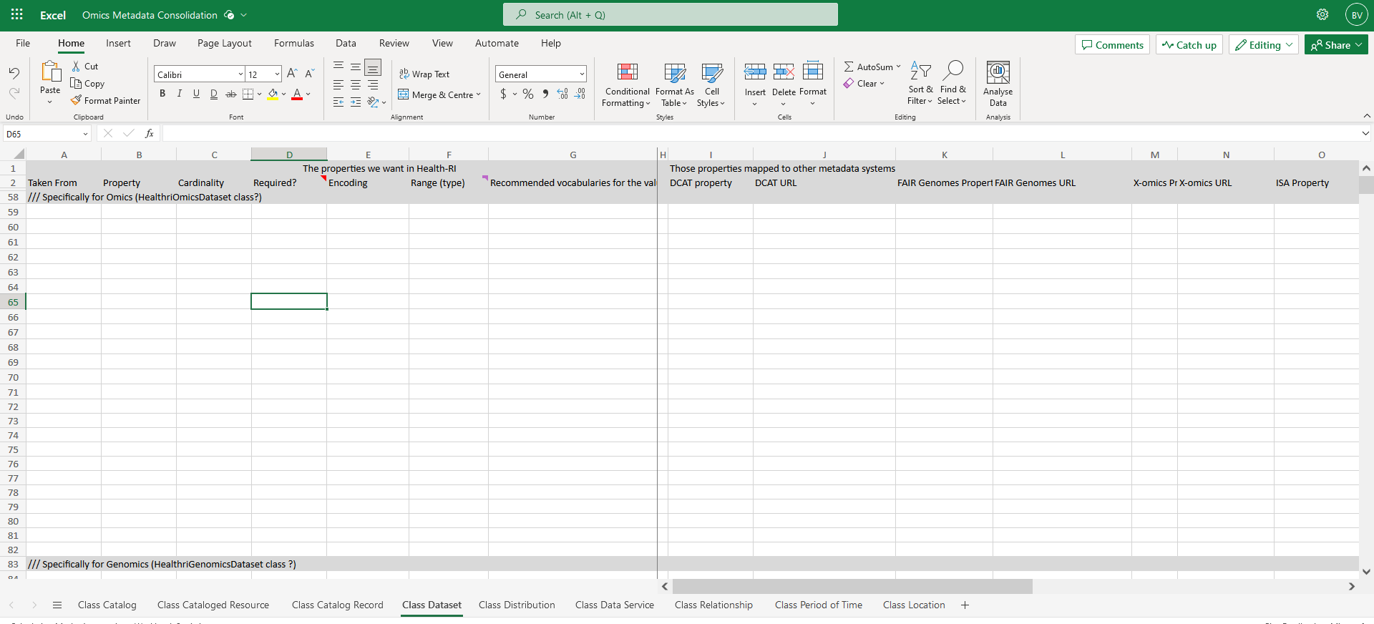
Health-RI domain (petal) metadata schemas
Funders
Omics
What Apart from DCAT AP Potals?
DCAT AP Portals
(mandatory fields)
Clinical
Biobank
0.9
2.0
Resources in a domain must offer, extra to the core, their minimal metadata to find their domain resources
Rare Diseases
Cohorts

Slide 19
Defining Leaves – domain Metadata
Domains (e.g. Image group) will specialize the generic/core schema into their needs and properties
Feedback / Result from Domain groups expected to be shared via Github
Request Rob 🧙 to add you to the HRI Metadata repo health-ri-metadata/Leaves/Image

Slide 20
Metadata schema -- Define a Scope What metadata should you prioritise?
-- Start by collecting requirement for the Core model
FAIR
Important to find your dataset (e.g. diagnosis, sample size, subjects (people, demo)
Increase accessibility (sharing protocol/access constraints)
Increase interoperability (which vocabulary, coding language was used in your data)
Increase reusability (consent/license, provenance, standards used for coding your data, study protocols as a quality standard, pointer to the data)
Other
Important for the “visuals” of the portal (e.g. Logo URL, Landing Page URL)
Important for your domain (e.g. imaging example)

Slide 21
Collect your Requirements (terms)
Collect all the metadata requirements in a form of competency queries.
For the specific data collection method, give me the data and title, format, publisher?
Give me the images with modality “mammography”?
Make an inventory of the important terms and their definitions
Collection method, image modality, collection title,
Define them in rdf compliant manner (class, attribute, relations, controlled vocabulary, taxonomies)
dataset
dataset tile
dataset created data
For each properties per class, define datatypes -> collection title xsd:timedate
For each properties per class, define:
mandatory/ optional
Cardinality 0..n

Slide 22
Reuse elements from DICOM
Reuse the exsiting standards your requirements to the existing standards
Reuse the domain standards
If your requirements are missing, make a new entity or extend the existing elements
DICOM® is the international standard to transmit, store, retrieve, print, process, and display medical imaging information” - From https://www.dicomstandard.org/, (Mildenberger et al, 2002)

Slide 23
Map and Align to dcat-AP
Understand Core metadata requirement:
Start by taking a comprehensive inventory of your current metadata terms and definitions.
Document each term, its definition, and possible values or data types (if applicable).
Study the DCAT-AP Specification:
Familiarize yourself with the DCAT-AP classes, properties, and controlled vocabularies. This will give you an overview of what is available and how it is structured.
Documentation for the DCAT-AP can usually be found on official EU websites or repositories related to open data standards.
Mapping & Alignment:
For each term in your current metadata schema, identify a corresponding class or property in DCAT-AP.
If a direct match doesn’t exist, consider whether the term can be mapped to an extended class or property in DCAT-AP, or whether it can be represented using a combination of available classes or properties.
Address Gaps:
If you find terms in your metadata that don’t have a corresponding representation in DCAT-AP, you will need to decide how to address these gaps.
You might consider extending the DCAT-AP schema (by creating custom classes or properties).
Document Your Decisions:
Maintain a crosswalk or mapping document that records how each term in your metadata is aligned with DCAT-AP. This will be valuable for future reference, training, or auditing purposes.
Implement the Alignment:
Update your metadata capture, storage, and publishing tools to use the aligned schema.
If you're developing a new system, ensure that the software respects the DCAT-AP alignment.

Slide 24
Health-RI git repo
DCAT-AP specification and models
https://github.com/Health-RI/health-ri-metadata/tree/master/DCAT-AP
Metadata Requirement sheet
https://github.com/Health-RI/health-ri-metadata/blob/master/Leaves_Petals/metadata%20collection%20sheet%20template.xlsx

Slide 25

Take away
Define your metadata scope and requirements
Identify pre-existing standards in your field and map your requirements to it, “DICOM” Ontology
Request Rob (or Jeroen) for GitHub access
Model your requirement in graph model (class, properties , relations).
Map your model to the dcat-ap model. Excel sheet
Keep your versioning in GitHub 🌻
Need specialised help? Talk to your group leaders 🧙
Need more Metadata/Modelling/FDP help? Talk to Bruna Vieira, Dena Tahvildari, Luiz Bonino, Kees Burgers.
Want to offer help? Contact us!

Slide 26
Acknowledgements
Julia
Kees
Luiz
Mijke
Marianne
Jeroen
Rita
Esther

